Slide 1
Refund / Amount Owed
Pub 4012 Tab K
(Federal 1040-Lines 75-79)
Notes:
1

Slide 2
Federal Refund Options
Refund by check - no action needed
Refund via direct deposit – enter account info twice in TaxSlayer
Faster & safer
Specify account type
Enter both routing & bank account #s
To split between 2 or 3 accounts, use Form 8888 *
Use refund to purchase bonds (use Form 8888)
Use refund to apply to next year’s tax liability
* Do not enter amounts for each account until return figures are finalized, so that refund amount is final
Notes:
Form 8888 must be obtained from IRS website
2

Slide 3
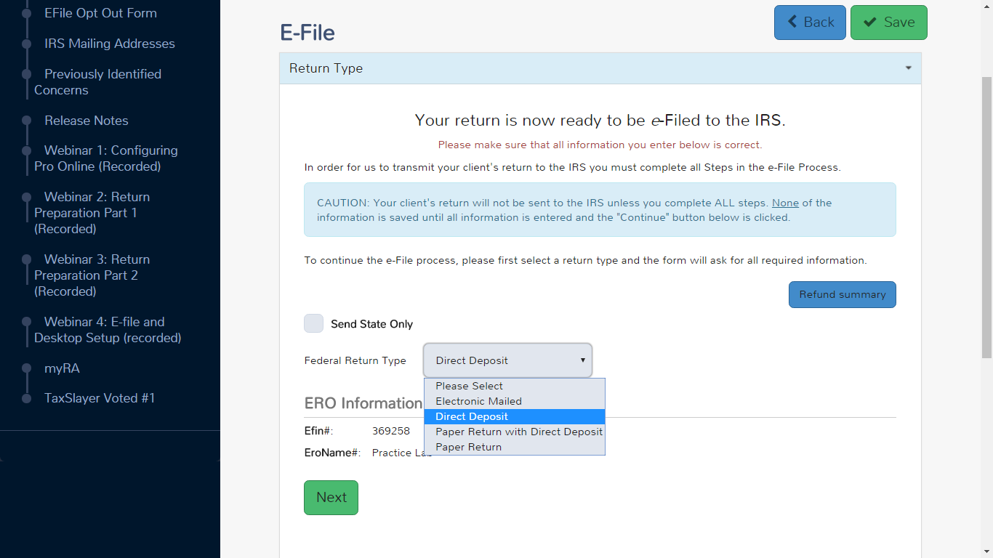
TS – Federal Refund Via Direct Deposit E-File Section \ Federal Return Type
Choose Direct Deposit from drop-down menu
as Federal return type
Notes:
4 options for Federal return type:
Electronic – return is e-filed, refund check is mailed
Direct Deposit – return is e-filed, refund is direct deposited into bank account
Paper Return with Direct Deposit – return is mailed in, refund is direct deposited into bank account
Paper Return – return is mailed in, refund check is mailed
3

Slide 4
TS – NJ Refund Via Direct Deposit E-File Section \ State Return Type
Choose Direct Deposit from drop-down menu
as State return type
Notes:
The State Return Type has the same 4 options as the Federal, but in a different order
4

Slide 5
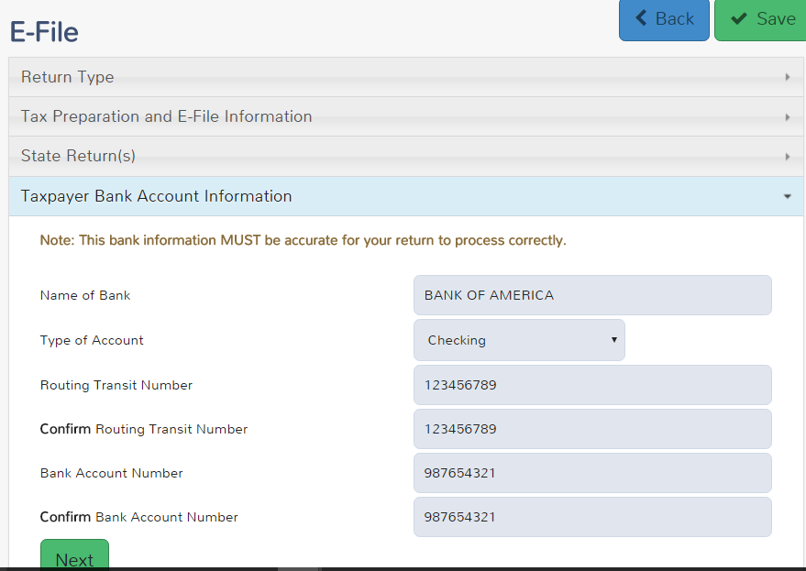
TS – Bank Information for Refund Via Direct Deposit E-File Section \ Taxpayer Bank Account Information
Name of bank
Type of account
Routing # (twice)
Account # (twice)
Notes:
For direct deposit of a refund, counselor must enter name of bank, type of account, bank routing # (twice) & account # (twice)
Routing # is 9 digits; should be taken from actual check, not deposit ticket
Bank account # should be entered exactly as shown on check, not including the check #
Entering an invalid RTN will result in a 4-6 week delay
New: If bank account number is not taken directly from a check, taxpayer must initial on paper tax return to confirm accuracy
5

Slide 6
Refunds Used To Buy Series I Bonds
Do not need an account to purchase bonds; instructions are on Form 8888
Obtain from IRS.gov website
Can buy for co-owners, e.g. - grandchildren
Can buy up to three in a range of amounts
Flat rate interest + semiannual inflation
Can redeem after 12 months (forfeit 3 months’ interest if redeemed < 5 years)
Taxpayer will receive the bonds (via mail or electronically) and a check for balance of refund
Notes:
6

Slide 7
Refunds Applied to Next Year’s Taxes
Can choose to apply all or part of current year’s refund to next year’s taxes
Enter in Federal Section \ Payments and Estimates \ Apply Overpayment to Next Year's Taxes
TaxSlayer will populate amount to be applied to next year on 1040 Line 77 and re-calculate refund taxpayer will receive this year
Can also choose to apply NJ refund to next year’s taxes
Enter in State section \ Edit \ Enter Myself \ Payments
Notes:
7

Slide 8
TS – Federal Refund Applied to Next Year’s Taxes Federal Section \ Payments and Estimates \ Apply Overpayment to Next Year's Taxes
Amount of refund applied to next year’s taxes
Notes:
8

Slide 9
TS - Refund Applied to Next Year’s Taxes – 1040 Page 2 Line 77
Original refund amount
TS reduces refund by amount applied to next year’s taxes
Amount to apply to next year’s taxes
Notes:
TaxSlayer transfers total amount of refund to be applied to next year’s estimated taxes from 1040-ES
9

Slide 10
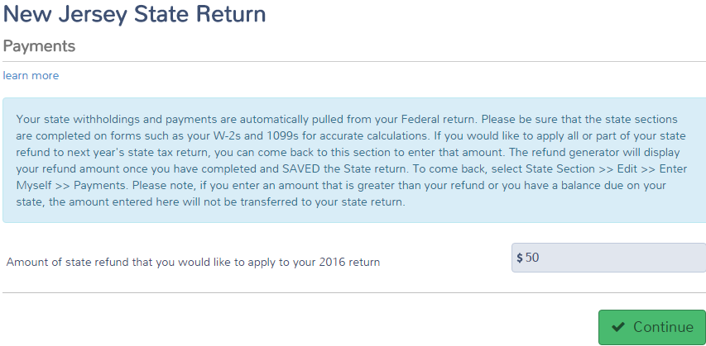
TS – NJ Refund Applied to Next Year’s Taxes State section \ Edit \ Enter Myself \ Payments
Amount of NJ refund applied to next year’s taxes
Notes:
10

Slide 11
Refund Offsets (Garnishments) - Items That Reduce Refunds
Garnishment occurs when Federal or State agency takes taxpayer’s refund as payment toward a debt
Unpaid Federal taxes
Unpaid state taxes
Earned Income Credit review
Owed child support
Unpaid student loans
Other non-tax debts
Notes:
Taxpayer’s refund amount may be decreased by the IRS due to the items listed here
This occurs once the tax return is filed & may or may not be expected by taxpayer. Counselor would not be aware of these items
11

Slide 12
Amount Owed: Payment Options
Check or money order - use 1040V voucher
Electronic funds transfer (direct debit)
File return immediately & specify date for transfer
Credit card (additional fee)
Installment payments (must arrange with IRS)
Use Form 9465
Interest & penalties apply
Taxpayer can request 60-120 day deferment but interest & penalties still apply
Notes:
12

Slide 13
Tax Penalty for Underpayment of Taxes
TaxSlayer will issue a warning during e-file process if taxpayer may owe penalty (i.e. - owes an amount greater than $1,000 (Federal) /$400 (NJ)
Penalty is Out of Scope, so choose option to file without including penalty (Form 2210)
Alert taxpayer that they may receive a letter from IRS or NJ
Make a note that alert was given to taxpayer in Intake/Interview sheet notes section and in TaxSlayer notes
Notes:
Counselors should discuss the possibility of an IRS penalty with taxpayer
If there is a penalty, the IRS will notify taxpayer with a letter
13

Slide 14
Conditions When Estimated Tax Payments are Required for Next Year
Taxpayer tax liability in current year more than what was withheld and/or paid in advance AND
Taxpayer expects to owe for next year more than $1,000 (Federal)/$400 (NJ) after subtracting tax withheld & tax credits from tax liability AND
Taxpayer expects next year’s tax withheld to be less than:
90% of the tax liability on next year’s return, or
100% of tax liability shown on current year’s return
Estimated taxes required if taxpayer is self-employed
Notes:
14

Slide 15
Federal Estimated Taxes for Next Year – Form 1040-ES
Calculate an estimate of next year’s tax liability
Pay 90% of next year’s estimated tax liability OR
Pay 100% of current year’s tax liability (safe harbor option)
Enter amounts for each required payment in Federal section \ Payments and Estimates \ Vouchers for Next Year's Estimated Payments
4 vouchers will print for submittal
Checks are made payable to US Treasury
Estimated tax payments are due on 4/15, 6/15, 9/15 of next tax year & 1/15 of following tax year (may change due to holidays)
Notes:
15

Slide 16
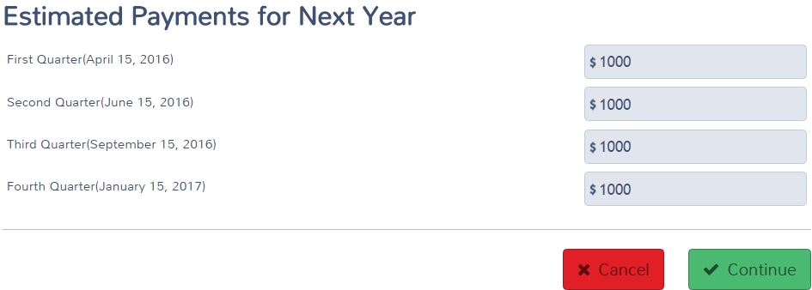
TS - Federal Estimated Taxes for Next Year – Form 1040-ES Federal section \ Payments and Estimates \ Vouchers for Next Year's Estimated Payments
Specify amount to pay
Payment due 4/15
Payment due 6/15
Payment due 9/15
Payment due 1/15
Estimated tax payment voucher
Notes:
16

Slide 17
TS – Federal Estimated Taxes Voucher for Next Year – Form 1040-ES
For taxpayer records
Cut off voucher and
submit with payment
Notes:
17
Remind taxpayer to mail estimated tax payment due on 4/15 separately from any balance due from the current year income tax return

Slide 18
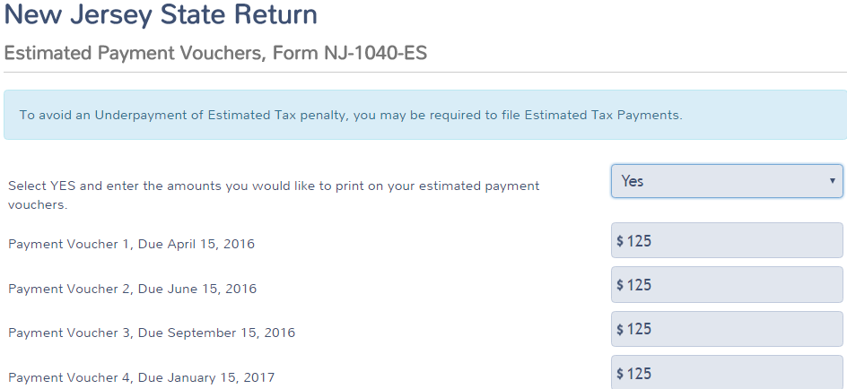
TS – NJ Estimated Taxes for Next Year - Form NJ-1040-ES State Section \ Edit \ Enter Myself \ Miscellaneous Forms \ Estimated Payment Vouchers, Form NJ-1040-ES
Choose Yes from drop-down menu
Payment due 4/15
Payment due 6/15
Payment due 9/15
Payment due 1/15
Notes:
18

Slide 19
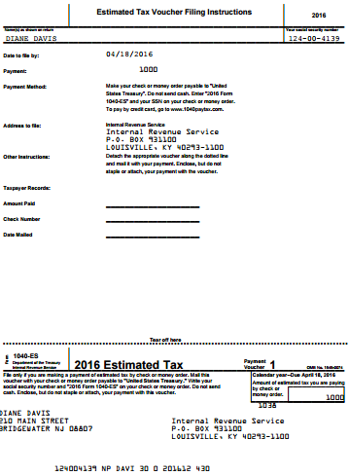
TS – NJ Estimated Taxes Vouchers for Next Year - Form NJ-1040-ES
For taxpayer records
Cut off voucher and
submit with payment
Notes:
19
Remind taxpayer to mail estimated tax payment due on 4/15 separately from any balance due from the current year NJ income tax return

Slide 20
Form W-4 & W-4P - Employee Withholding Allowance
Complete Form W-4 so that employer can withhold the correct Federal income tax from pay
Used if significant current year refund or balance due
Complete Form W-4P for withholdings from pension or annuity
Notes:
20

Slide 21
What If Taxpayer Cannot Pay?
Pay in full within 60 or 120 days with no fee, but interest & penalty will be charged on payments after due date
Apply to make monthly installments using Form 9465 Installment Agreement Request
Fee charged if granted; also interest & penalty
Use credit card to pay
American Express, Discover, MasterCard, Visa
Convenience fee charged by service providers
Notes:
21

